Slide 1
My Leadership Journey
Jo Catlin, Head of Organisational Development & Leadership

Slide 2
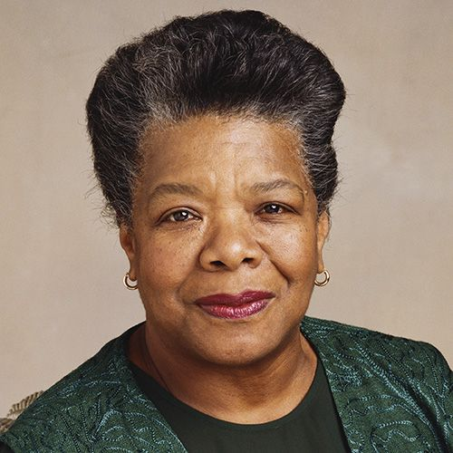
“People will forget what you said, people will forget what you did, but people will never forget how you made them feel” Maya Angelou
This quote often comes to mind when I think about the care and compassion delivered by my amazing colleagues day in day out in the NHS.
When I was asked to reflect on my own leadership journey, that same quote resonated. A manager early on once sat me down with a few wise words; listen deeply and be curious, there is always so much to learn from others, and take every opportunity you can to develop yourself and inspire others to do the same. In my 28 year career with the NHS, I have been fortunate to have had managers that made me feel supported, feel safe to experiment, felt valued, and a genuine belief in my potential, in what I could achieve.

Slide 3
I started in the NHS back in 1993, having just returned from working overseas. I tentatively applied for a year’s fixed term role in IT as a trainer at Peterborough District Hospital, keeping my fingers firmly crossed that the interviewers could see past my lack of NHS and IT knowledge, and focus on my potential, which thankfully they did! My first project was to roll out basic IT training to clinicians and clinical teams, and what an experience that was. I was thrown into the deep end, not only picking up the technology but the biggest challenge was appreciating the complexity and politics of working in the NHS. I quickly learned how people reacted to change, the importance of effective communication and just how vital a role leadership played in all of this. I listened, observed, and learned so much; never underestimate the power of experiential learning and mentoring from others. The development, support and training I have been fortunate to have received, with amazing managers that had the forethought of both my future and that of the services we deliver, planning the steps ahead. Seeing my potential at times when I couldn’t see it myself, setting me stretch projects and challenges, and most importantly having honest conversations about where my development gaps were at each transitional stage in my career.
All feedback is a gift! Technical and management training, project management and OD qualifications have given me solid foundations without a doubt, but the developments that have had the biggest impact are the ones that have shaped and shifted my thinking; my coaching qualifications and subsequent experience as a coach – I am forever learning about myself and others. The NHS and Kings Fund co-created ‘Change Leaders’ programme, for the content, multi-disciplinary cohorts were key, at a point when I needed to work differently.

Slide 4
The Leadership Academy programmes and workshops, have been invaluable for the content, support, and networking through the communities it creates. Leaving IT to experience life in operational management with Cancer Services was a significant change and challenge, far out of my comfort zone, but taught me well. Getting involved in projects has also developed both my skills and my thinking e.g. becoming a Foundation Trust, moving to a new build hospital, organisational mergers and even volunteering for charities and organisations that support the NHS. Above all else, working through the pandemic reinforced the importance of looking after each other. It’s cliché but it’s true, our people are our biggest asset, and we need to be kind, value and inspire each other.
I am thankful to the people that have and continue to inspire me every day, to the leaders that have believed in and mentored me, and to the opportunities the NHS has presented me over the 28 years; from an IT trainer, with various project and operational management roles in between, to finding a profession that I love, Organisational Development (OD), and being recognised for ‘Excellence in OD’ as a HPMA finalist in 2017. I feel l very proud and privileged to currently hold the role of Head of OD and Leadership for Norfolk and Waveney CCG and looking forward system and partnership working in the ICS in 2022

