Slide 1
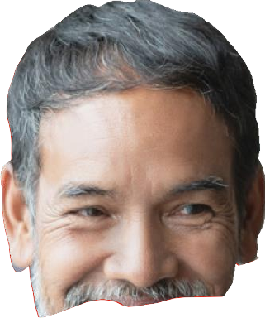
NHS Career Management Guide

Slide 2
2

Slide 3
3

Slide 4
4

Slide 5
5

Slide 6
JOB SEARCHING
Personal details
Your personal details should always be included on your CV. Providing the correct level of information shows professionalism. TIP: Including an online professional profile, such as LinkedIn can be helpful to employers and recruiters.
undertaken, and achievements gained, when highlighting achievements focus on the feature, action, benefit model to add structure and ensure you select the most relevant achievements for the role you’re applying for.
Education and Qualifications:
Give a summary of your educational and professional qualifications. TIP: Include only the most relevant for the job and always start with your most recently gained educational qualification.
Personal Profile/Statement
A personal profile is a short, summary of your CV, a bit like the “blurb” you read on the back of a book you might be tempted to buy. The profile should encapsulate you, so the reader has an idea of who you are before they read the rest of your CV. It’s an opportunity to highlight your best points and make the employer want to read on, keep it short and use positive language. Aim for between 4-6 lines. TIP: Tailor it to the role and avoid generic buzzwords.
Cover Letter
A cover letter is your chance to elaborate on your relevant skills and experience by highlighting your past accomplishments and explaining how they’re relevant to the position you’ve applied for.
Career / Employment History:
Detail your employment history, starting with your current or most recent. TIP: Make sure that any
experience you mention is relevant to the job you’re applying for and back up your skills with facts or statistics where possible. Making your experience tangible by using statistics will allow the reader to
understand the size and scale of your role or project. Reference both the role responsibilities you have
Your cover letter needs to provide this information and leave the reader convinced that you are the right person for the role they have advertised. Your CV exists to progress you to interview and should represent an honest and authentic review of your achievements and experience for the role you are applying for, whilst also conveying your drive and determination to make an impactful first impression.
6

Slide 8
Building your LinkedIn Profile
JOB SEARCHING
Benefits of LinkedIn and how to build your Profile
Having a professional and informative LinkedIn page helps you manage your professional brand, keeping people updated on your career, who you are and also an insight into your values and interests.
+ Build a range of networks across the NHS and the health and care sector to share best practise, hear about events and ask questions to other professionals in your sector.
www.linkedin.com
Once you have built your profile it will be visible to all LinkedIn users, however it’s important to review the profile privacy preferences and settings, so you can control what appears on your profile and also what other people can see about your updates. profile privacy preferences.
References:
For further information please visit the LinkedIn website where you can find further tips and hints: https://uk.linkedin.com/
Benefits to having a profile on LinkedIn:-
+ Manage your professional brand, let people view your experience and qualifications and track your milestones i.e. new jobs, promotions)
+ See a range of job opportunities and search for roles
– find jobs on LinkedIn.
8

Slide 9
–
9

Slide 10
Top tips from LinkedIn/ NHS Jobs/Trac
JOB SEARCHING
Job search filters
Use the following filters on the job search results page to refine your results:
Location - You can specify a location for your job search by entering a location
Date Posted - By default, your job search results will show results from any time, but you can also choose to display jobs posted within the last 24 hours, the past week, and the past month.
Saving Jobs of interest
When you search for a job on LinkedIn, you can save it at any time by clicking the Save button on the job details page.
To access your saved jobs:
Click Jobs at the top of your homepage - Click Saved Jobs above the search bar at the top of the page.
Creating Job Alerts
You can create job alerts on LinkedIn to stay updated with new job postings that match your preferences. You can choose whether you want to receive these alerts on a daily or weekly basis through email, app notifications, or both.
Search for a job on LinkedIn
At the top left of the job search results page, switch the Job alert toggle to On to create a job alert for your current search criteria.
In the Create search alert pop-up, select how often you’d like to receive alerts about new jobs on LinkedIn that fit those specific search parameters from the Receive alert dropdown.
Select how you’d like to get notified from the Get
notified via dropdown.
4. Click Save.
Apply for Jobs on LinkedIn
If you see a job that you’re interested in as you search for jobs, you can easily apply for it on LinkedIn. Based on what the job poster chooses, you’ll see an Easy Apply or Apply button.
Note: If you see the Apply button instead of the Easy Apply button, you’ll be routed to that company’s website or job board to continue the application process.
Once you apply for a job, you can’t withdraw or modify your application submitted through LinkedIn. You’ll need to directly contact the job poster through an InMail.
1

Slide 11
This overview has been designed to provide you with useful information and guidance on how best to approach completing a job application.
The application will require the completion of several role specific questions or a personal statement. Shortlisters as well as reviewing your relevant experience and qualifications will focus on the personal statement to confirm whether the applicant will be shortlisted for an interview against the essential and desirable criteria for the job.
Spend some time identifying what your key strengths are and examples in your current role and previous roles to show that you can meet the criteria for the job. You can identify these ahead of completing the application and use one solid example that will cover these as there will be a word limit on the personal statement.
When planning your personal statement Consider:
+ What is the main purpose of the role(s)?
+ Why is this role important to the organisation(s), the NHS and patients?
+ What are the key skills and experience required?
+ What personal qualities, values and behaviours are needed to make this role work most successfully and map your examples against the role requirements?
+
Top tip: Ensure that you allow enough time to complete the application. It can take time to complete a quality personal statement and some roles may close early if they receive a high number of applications.
 |  | Further information (Links) + You can view further help on completing the application form here. + Practise and perfect your interview technique with the help of videos from leading industry professionals via Be My Interviewer. + For a more detailed overview on how to complete an application on NHS jobs please click here.
1

Slide 12
Once completed and before submitting consider the following pointers:
1. Try to put your application to one side for a while, overnight if possible, and then come back to it and review it with fresh eyes.
6. Remember: A spelling and grammar check is essential to create and maintain a positive first impression.
2. Is it brief, to the point and easy to read?
7. Cross-reference your application with the key skills, attributes and requirements of
3. Ask a trusted friend or colleague for honest feedback – they may spot things you’ve missed or strengths you haven’t recognised.
8. Have you read and addressed all key criteria?
4. Present yourself professionally. Keep sentences and paragraphs concise.
9. Don’t be modest: Be honest and authentic but also confident about your experience, achievements and skills, readers will not have time to ‘read between the lines’ – make it easy
5. Don’t include irrelevant material that does not
differentiate you or add to your narrative.
1

Slide 13
for them to see how what you’ve done in the past
demonstrates what you can deliver in the future.
10.
Ensure you clearly articulate why you want the
role (this will help to demonstrate your prior research and knowledge of the organisation).
11.
Ensure you have highlighted not only technical
skills and experience but also your values and leadership approach.
the role(s) you are applying for – have you adequately highlighted these?
Next up:
“
Interviews
As you progress through senior levels, I find there is less about technical competence, (that is assumed via application, position held, references etc) and interview panels are far more interested in you, your leadership style, risk, governance and of course your own views and thinking on a range of matters!
Lisa Crichton-Jones
Executive Director of People and OD Gateshead Health Foundation Trust
1

Slide 14
1

Slide 15
Interview and Presentation
.
Hints and Tips
Before the interview:
1. Ensure you are aware of the organisation’s key information, number of employees, strategic objectives, CQC reports and any USP etc.
6. Consider examples that in the recent past which demonstrate how you meet the role criteria.
7. Ensure you’ve considered your vision for the role and the wider strategic context. You will need to be able to articulate clearly what your key priorities would be over the next 12 months and what impact you would hope to have if appointed.
2. Ensure you are aware of who is on the panel and their areas of expertise.
3. Consider the job description and requirements of the role you are applying for against your key values, skills, strengths, knowledge, and achievements.
8. Take your pre-prepared examples into the interview as a prompt.
4. Draft scenarios - think about the types of questions you may be asked based on the job description and construct your ideal scenario-based answers using a STAR model (see below for STAR model).
9. Don’t forget the practicalities – personal presentation, travel plans, parking, how you will get yourself in the right frame of mind and how you will handle any difficult questions?
5. When preparing your scenario questions consider how you’ve added value to the organisation, system, patients, team, and others within a strategic context.
Use this to prepare examples to demonstrate how you have succeeded before and will do it again.
1

Slide 16
INTERVIEWS
On the day of the interview: + Remember, this is about you. Don’t spend too much time setting up context – ask the interviewer if they have enough context and move on. What they want to know is who you are and what you will bring – spend the most time here. + Speak clearly, manage the pace of your response and what your body language might suggest. + Don’t shy away from promoting yourself, use examples and leverage your brand and purpose. + Connect and build rapport with colleagues on the panel. | + Demonstrate enthusiasm – show how you are genuinely interested in the role. + Ensure you actively listen and observe. + Avoid using jargon and set pieces – make the interview personal to you, showing who you are, what you did or would do in a situation and how you prefer to lead through others. + Demonstrate desirable leadership behaviours and attitudes. + If you are unclear about anything, ask for clarity.
1

Slide 17
Interviews and Leadership Competencies
Presentations A presentation, whether to a large group of stakeholders or the interview panel, will often form part of your final panel process. Presentations are often done as a way to assess how you communicate as a leader, engage staff and stakeholders and how you cope under pressure. When presenting always: + Follow the Instructions – Ensure you are clear on what you are expected to present. | + Prepare – prepare and practice your presentation – do this with and without notes. + Body Language – Make sure you convey a positive image by using body language employers look for such as smiling, eye contact, looking at the person who asked the question when answering. + Tonality – Vary the tone of your voice to maintain the panels interest.
For helpful hints on presentations and confidence follow the below links:
Competency based interviews (CBIs) are also often known as structured or behavioural interviews. They generally consist of a number of targeted questions that require interviewees to describe a specific task or situation. CBIs work on the assumption that the best indication of an individual’s future behaviour is their past behaviour.
Values based interviews (VBI) is an approach which selects employees on the basis that their individual values and behaviours align with the values of the NHS Constitution. It ensures that we recruit the right workforce not only with the right skills and in the right numbers, but with the right values to support effective team working and excellent patient care and experience.
1

Slide 18
INTERVIEWS
Suitability for the role will be assessed by asking questions about:
+ Past performance.
Example interview Questions:
Tell us about a time you have led a large scale and complex change that delivered tangible results (What are the quantifiable numbers associated with this example).
+ Learning from past
+ Values and behaviours
+ Future adaptability to the post
+ Knowledge andunderstanding of challenges in relation to the post
In Health and Care, it is important that as leaders we focus on reducing health inequalities and increasing equality, diversity and inclusion. Give me an example of where you have demonstrated your commitment to improving equality, diversity and inclusion?
Can you give me an example of where you had to work across organisational boundaries with different stakeholders. What did you do and how did you go about building relationships?
What’s the most significant and far-reaching organisation/systemwide strategy that you have led or implemented?
Tell me about a time you stayed true to your own values and demonstrated your integrity to others.
Video: Understanding the
Core Competencies and Interview Guidance
This video articulates the main core leadership competencies and also provides more useful interview advice, including examples of how to structure interview answers using the STAR technique Link to the video: here
2

Slide 19
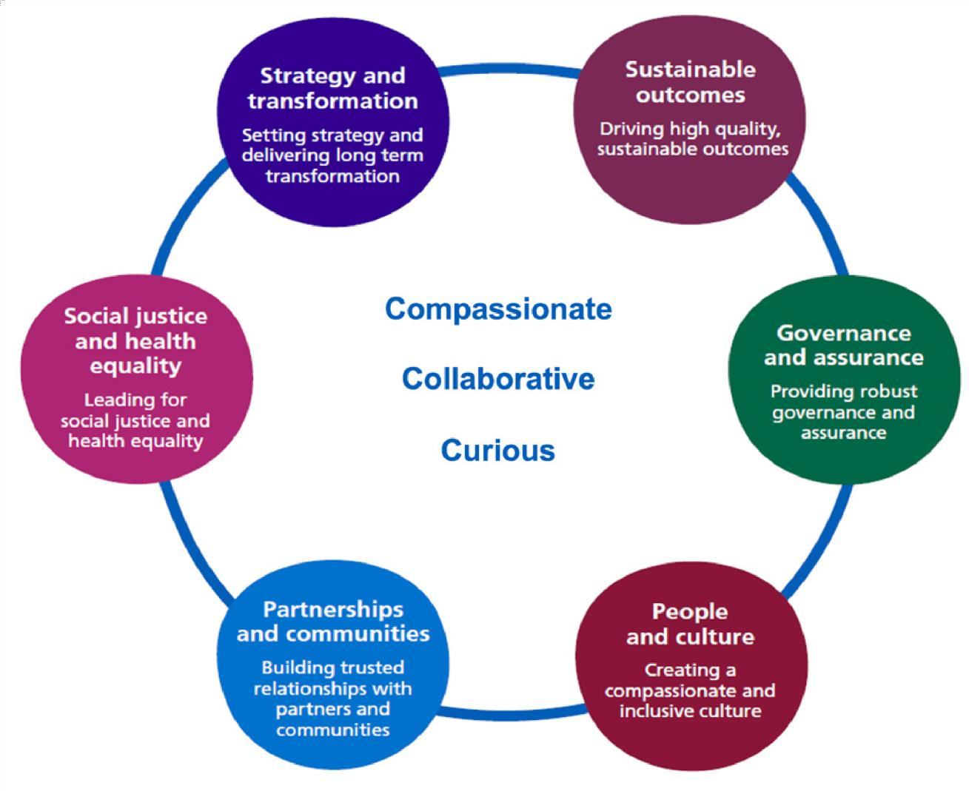
2

Slide 20
Executive Interviews and Inclusive Leadership
INTERVIEWS
Informal meeting with the Chief Executive
Prior to the final panel interview you may be invited to have a 1-2-1 meeting with the Chief Executive (assuming the appointment is an Executive Director role).
Stakeholder Engagement Sessions
The recruiting organisation may invite shortlisted candidates to attend an event where they have the opportunity to find out more about the role and organisation.
Site visits
You may be invited to visit the organisation’s site accompanied by a potential future colleague, peer or member of the leadership team.
Presentation
For many panel interviews, candidates are asked to prepare a short presentation for the panel. The presentation is often on a topic that is specific to the challenges of the organisation, or that seeks to understand your likely approach to the role should you be successful.
of forms from ability tests or personality profiles, through to in tray or situational exercises.
Assessment Centres
Assessment centres can be used for a variety of roles; these range in duration from a couple of hours to a full day. The assessments are designed around the values and the specific requirements of the role you are applying for. Assessment centres may use the following to assess your suitability to the role: situational judgement tests, group exercises, simulation exercise, verbal reasoning tests or numerical reasoning tests.
+ | Top tip: You may want to consider taking some practice psychometric/reasoning tests (available online) to familiarise yourself with the types of questions and the test structure.
Situational Judgement Example: “What would you do if...” Having read a fictional scenario, typical of one an Executive Director would find themselves in, explain what you would do exploring: + What would you be thinking? + What would you want to know more about and why? + What action would you take? + What risks would you pay attention to?
+ | Top tip: If you are to make the presentation by PowerPoint, ensure the right equipment will be there to help you and technical support is on hand.
Psychometric assessments
You may be asked to undertake some sort of psychometric testing. They can take a variety
2

Slide 22
INTERVIEWS
Final Panel Interview
The panel interview itself is conducted by a range of senior stakeholders from within the organisation supported by one or more professional experts whose role it is to offer their view on each candidate’s professional competence. Usually, each member of the panel will ask a question or cluster of questions on a particular topic of interest to them and of
Demonstrating your Inclusive Leadership
Compassionate and inclusive leadership builds connection across boundaries, ensuring that the voices of all are heard in the process of delivering and improving care. In order to nurture a culture of compassion, organisations require their leaders – as the carriers of culture – to embody compassion and inclusion in their leadership.
general relevance to the performance of the
Where leaders model a commitment to high-quality and compassionate care, this impacts everything from clinical effectiveness and patient care to staff health, wellbeing and engagement.
role.
+ Top tip:
Inclusive cultures depend on inclusive leaders therefore you will need to ensure you showcase your knowledge and commitment to the Equality, Diversity and Inclusion agendas.
Whilst each part of the process may be considered important usually the panel interview carries the most weight in the decision making process. The panel will usually decide if each shortlisted candidates considered “appointable”.
This may include:
+ The importance of allyship.
+ The importance of representation across the workforce.
+ Action and ownership of the agenda at all levels.
+ The importance of leadership accountability.
Get in the zone. Everyone gets thrown in interviews, being judged makes people nervous. Consider what triggers you and what you think, feel or do in the moment before the moment before you lose it. Prepare tangible strategies to get your balance back, eg. having a sip of water, touching an object like your glasses or thumb. Practice your strategy in advance while you are calm and centred. In virtual interviews some find it helpful to put a photo of a person who regularly helps get you ‘in the zone’ near the webcam.
Fiona Rodden
Head of Talent, South East
“
2

Slide 23
2

Slide 24
2

Slide 25
Contact details
For further guidance regarding Talent Management and details of support offers available in your region please contact your regional talent team using the email documented below:
REGIONAL TALENT TEAMS
Your Regional NHSE Talent Team Contact:
East of England - england.talentandleadership.eoe@nhs.net
NHS IMAS Contact:
NHS IMAS provides interim management and consultancy support across the NHS for organisations requiring short or medium-term support and our pool members are given the opportunity to learn, develop and progress. They can offer their talent pool members a unique platform to access a variety of interim opportunities across all NHS organisations and specialities.
Contact: nhs.imas@nhs.net
The Online learning hub-
Catalogue
is a library of tools to help support you develop your career. Register to the learning hub to access “NHSE Talent Career Development” Resources
2

Slide 26
2

