Slide 1
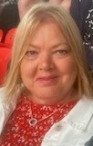
My Journey Sharon Louzado- Leadership and OD project Manager-Talent HCT March 2023
Notes:
Sorry I cant be with you today at the community of practice and thank you to pat and her team for asking me to share my journey and insights during my career particularly related to leadership a, OD and talent management before I skip off on my next journey of retirement.

Slide 2
Where it all started
My inspirations
Key points
Talent Management tips
Notes:
I thought I would share with you all where my career started showing that being agile, seeking opportunities, always learning and developing are key to being whatever you want to be.
To share with you some quotes that inspire me
Some key points that made a difference to my career
And finally some tips to take forward Talent management

Slide 3
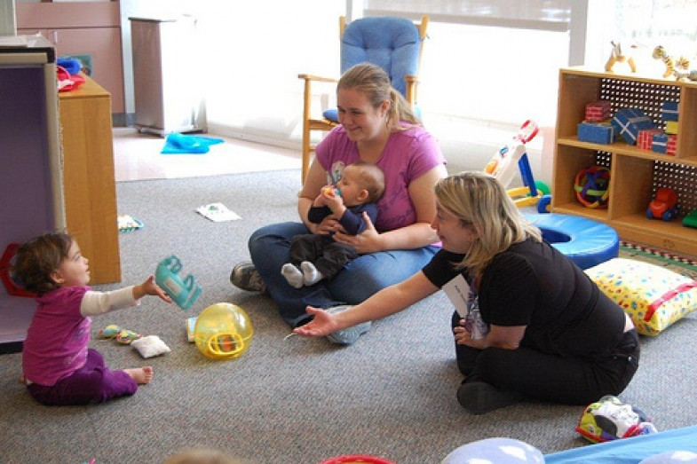
Talent
Management
This Photo by Unknown Author is licensed under CC BY-ND
Notes:
My NHS career started in January 1984 as a student nurse at the age of 19- a huge life changing experience which helped form the person I became as I moved through adulthood- I knew I enjoyed challenge, and making a difference to people. I also knew that after a period of time on a medical ward ill people weren’t necessarily for me.
I then trained as a midwife and thoroughly enjoying this for 4 years , however at this time working in the community was difficult to achieve and I wanted more autonomy and variation hence training to be a health visitor
10 years in H. visiting working in challenging communities provided me with the excitement and opportunities to grow and really make a difference- my interest in education, learning and development grew as I increasingly became involved in student and specialist training .
Operational and clinical management gave me the insight into what we needed to have in place for our workforce to ensure safety, quality and competence… When I was contacted by another community trust to take on and education role for clinicians it seemed the right time to move away from clinical practice
the professional educational manager became a learning and development manager focussing on all training clinical and non clinical and allowed me to build a learning and development team made of leads for each professional groups, mandatory and all other elements of training.-
After a brief break working for the local authority setting up extended schools and children centres I was lured back to the NHS in my old team as head of leadership, management development – building the offer available to the organisation and working with partners to achieve great leadership and management opportubites.
Again needing new challenges I took on the role of talent lead for the organisation – a great opportunity to embed this in to the culture in a focussed piece of work rather than being tagged onto my old role. I will talk about achievements later

Slide 4
Statements that keep me grounded
Every day may not be good, but there is something good in every day.
If Plan A doesn’t work, the alphabet has 25 more letters.
A dream doesn’t become reality through magic; it takes sweat, determination and hard work.
If your ship doesn’t come in, swim out to it
Don’t be afraid to fail. Be afraid not to try.
Notes:
These statements have supported my growth and kept me going when I'm feeling challenged or a little lost- there are many quotes by great leaders on leadership that also resonate and that you will all be aware of too

Slide 5
The Impact of HCTs Talent Management
Quality improvement - right person in right job with appropriate skill set = improved patient safety
Financial performance - reduced turnover rates, improved retention rates, opportunity to share talent resources across the system
Staff survey - improved staff satisfaction due to meaningful conversations and opportunity, increased internal growth/promotion
System working-greater resource for system, shared development and roles
EDI - transparent processes, opportunities and challenges to meet organisational and national targets

Slide 6
Our TM Successes
Career conversations embedded in appraisals
Readiness/Potential ratings currently recorded in BI portal
Talent manager in post leading work
Succession planning and critical role identification work in Operational and corporate business units in place.
TM forms part of the Workforce planning steering group
Talent Programmes for b2-4, b5-7 and b8+ in place. With positive impact evidenced, career conversations and learning mentors offered as part of the programme.
HCT culture supports TM - HCT was an early adopter site for the diagnostic tool kit and pilot site for S4G framework
HCT is currently undertaking the NHSi Cultural and Organisational assessment

Slide 7
Key learning points to embed TM
Get executive buy in- link to strategy and culture
Have a plan
Start small and grow
Create allies
Use templates
Demonstrate impact and value in the work through reporting.
Access TM resources/training/support
Work / support/share TM within the community of practice
Notes:
We linked TM work to the people plan and workforce plan and reported into the relevant committees
I developed a delivery plan to monitor progress
We started succession planning and identification of critical roles for teams in the operational business units – adults then children's with the senior management team and then rolling out to band 7 level. Once this was embedded we rolled out to all corporate business units ie quality, finance, strategy and transformation, integrated business teams
Use your senior leaders to share the good messages with their peers
Use consistent paperwork/templates- we used those provided by the leadership academy as part of the resource/tool kit and adjusted these to meet our needs
It was important to show the value in doing TM- we reported on development interventions, retention rates, portfolio restructure etc
We were lucky to access the regional 4 day TM programme- this kick started our journey providing us with knowledge , confidence, resources and a network of like minded colleagues. The COP has continued with this as has the Futures Platform.
As above connect with colleagues, share good practice, learn from each other

Slide 8
Thanks and sign off
Thank you to the Talent and Leadership team- Karen, Pat and Hannah for their ongoing support, dedication and provision of opportunities
Thank you to all of the Community of Practice colleagues who have so readily shared their TM journeys
Thank you to Andrea at Silver Maple for inspiring and supporting me to drive forward our TM agenda
Good Luck to you all

