Slide 1
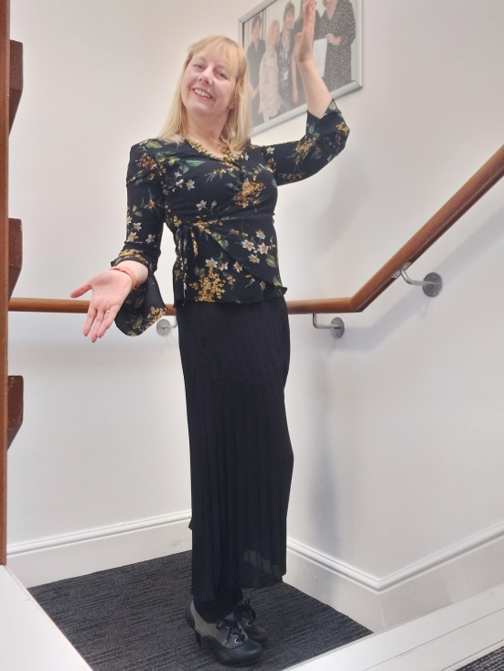
Sallyann Woodthorpe's Leadership Journey

Slide 2
My Leadership Journey – Sallyann Woodthorpe (17/09/21)
“Leadership is about making others better as a result of your presence and making sure that impact
lasts in your absence” Sheryl Sandberg, COO of Facebook
I am at a loss as to where that started! I was a shy child until I found my voice at about 16. Until then I only wanted the people around me to be happy and thrive, so maybe that WAS the start of my Compassionate Leadership Journey?
My early passion was art; I worked on commissions, my own work, and studied a BA (Hons) Fine Art then an MA in Museum Studies, working in Museums as a researcher and art workshop facilitator. However, all my student jobs had revolved around people, and customer service, so in Museums it was no surprise that I became involved in managing artist’s contracts, negotiating their terms and conditions, and quite frankly the “HR bits”. Taking art workshops to young people in areas of deprivation, developed mentoring and training skills and honed my ability to listen curiously. Life took me to London where I studied an MA in Personnel and Development (CIPD) which gave me a raft of Leadership and Management theory and I moved into a full-time Senior HR Officer role in a Futures and Commodities Company, with a couple of HR advisor to manage. The pace was fast, and we were always on a back-foot having to demonstrate our value as a “back-office function” and negotiate our budgets. Our American Parent company had part of its workforce in the twin towers, so 9/11 was significant in learning how to lead through change and support team’s resilience.
Having had children and worked for myself as a HR Consultant with several small businesses, as a HR Manager for an engineering firm and as a Step Ahead Mentor with the CIPD I found my home in the NHS through mentoring at a Regional College. This opened the door to a job with HEE and a CCG supporting career development and Apprenticeships in GP Practices and enabled a good understanding of the NHS as a “system”.

Slide 3
Leading through COVID
Self-awareness, compassion, inclusion and resilience have never been more important, for many of us as leaders; our private lives have spilled over into our professional lives, with dialling in to MS Teams at home and trying to maintain our own mental wellbeing and that of our teams. My real passion, coaching, has come into its own during Covid. In the last three years I have honed that by qualifying as a ILM Coach, setting up the coaching community at CCS, offering group coaching and developing `Coaching Conversations’, embedded into a lot of our training programme. This has also influenced reverse mentoring, in response to the Black Lives Matter movement and supported better understanding amongst our leaders to demonstrate how we can “Live our Values”.

Slide 4
Are you still creative?
I think creatively, but for years I have kept my “art” and HR, separate until February 2020 when I attended an Introduction to Art Therapy. Although I had no intention to become a therapist, I have used creativity to open up coaching sessions where coachees have become “stuck” or disengaged. I am currently on a year’s secondment into a Senior OD Practitioner role at CPFT, to learn more about how we improve the overall effectiveness of an organisation through managing the behaviours of people within that organisation.
As Covid restrictions ease, we need use this learning to re-build the NHS and ensure effective growth and longevity of services. Beyond my NHS leadership role, I am a Group Scout Leader and often help with our Cub sessions.
What would you tell your younger self?
“Seek out feedback and get yourself a mentor”, I’ve had some inspirational women and men in my life who have challenged my mindset and pushed me professionally.
“You ARE enough”, being an authentic leader, warts and all is the way forward.

